Slide 1


Hack Hazard
Revolutionize Payments with Shielded Penni

Slide 2

Problems we are tackling …
People lost more than $10 billion to scams last year, an increase
of 14% from 2023
lack of Stable Currencies
lack of Financial Knowledge
Transactions with blockchain take time and use a lot of Gas

Slide 3
SCAM PREVENTION
Excessive consumption
of fuel
We Are AIM To Solve The Problem
Minimum Time Path and Processing
Supply Demand regulation

Slide 4
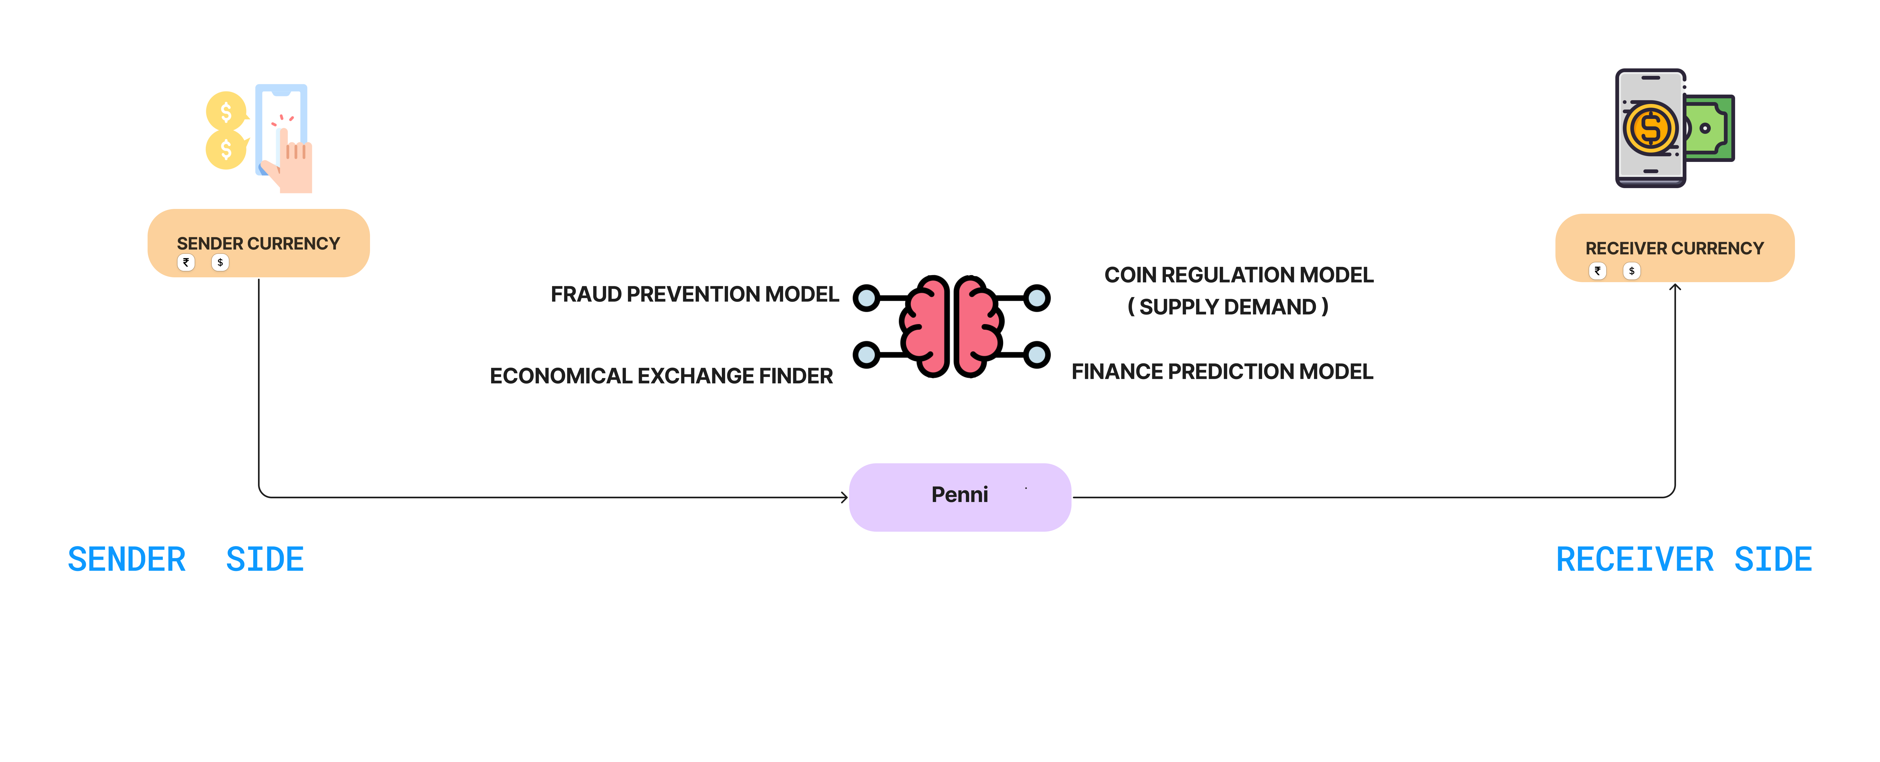
Flow Chart

Slide 5
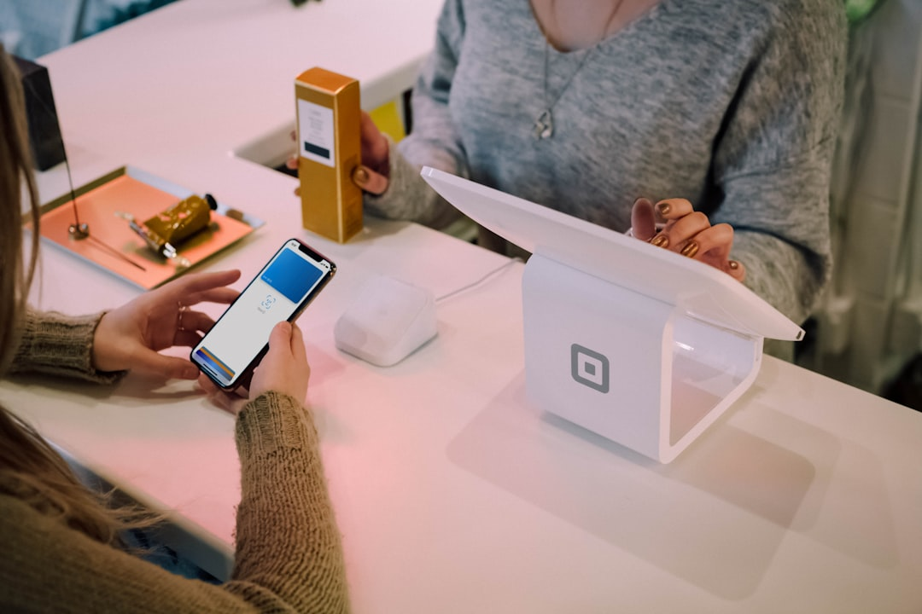


Key Features and Benefits
Fast Transactions
Enhanced Security
Lightning fast transaction speeds
Uncompromising security measures
Transparent Records
Immutable and auditable transaction history

Slide 6
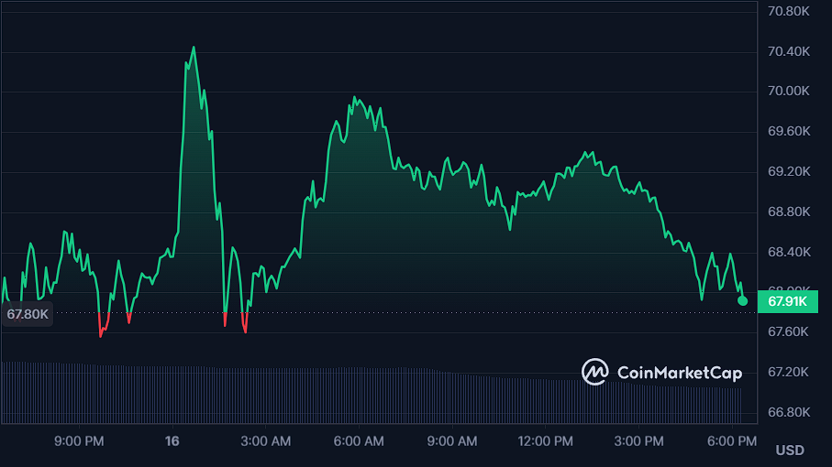
Business Model
Loans
SAS ( Software as Service )
B2B
Transection fee
Token value appreciation

Slide 7
Conclusion
Future prospects of blockchain payments
Level 1 block chain implementation
Platform as Service
Tokenized assert trading

